Slide 1
Light Transport Simulation with Vertex Connection and Merging
Paper introduction
Iliyan Georgiev*1, Jaroslav Křivánek*2, Tomáš Davidovič*13, and Philipp Slusalle*14
*1: Saarland University
*2: Charles University, Prague
*3: Intel VCI, Saarbrücken
*4: Intel VCI & DFKI, Saarbrücken
ACM ToG Vol. 31, No.6 SIGGRAPH Asia 2012
ichi-raven
* All figures without annotation in this slide are quoted from the same paper

Slide 2
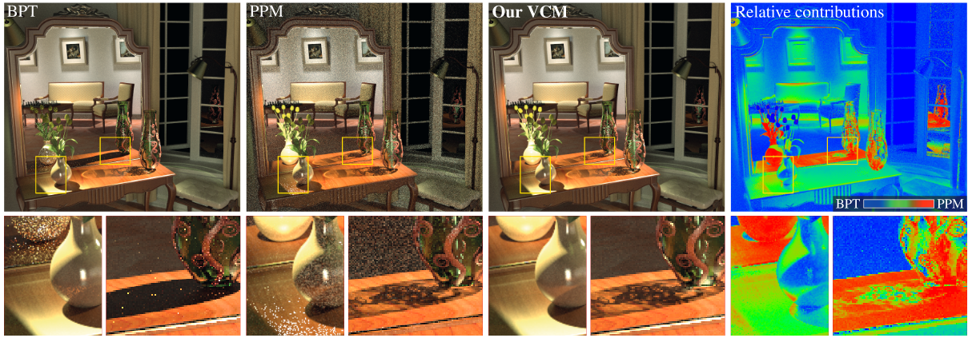
Introduction
Robust light transport simulation integrating - Bidirectional path tracing (BPT) - (Progressive) Photon mapping (PPM)
Teaser image

Slide 3
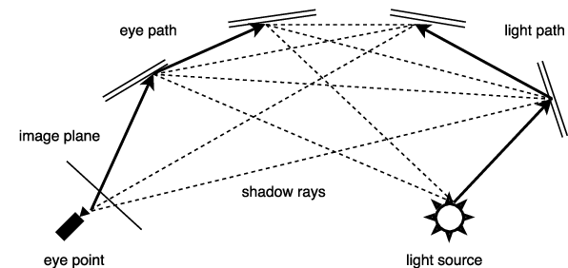
Background: BPT
Path tracing is always suffering from MC noise… → Various methods have been proposed, like BPT, PPM, MLT, etc.
Bidirectional Path Tracing (BPT): Conventional path tracing trace paths (only) from the viewpoint
→ Trace the path from the light source and consider all possible combinations of connections!
→ Significantly reduces MC noise of indirect light
BPT’s overview [1]

Slide 4
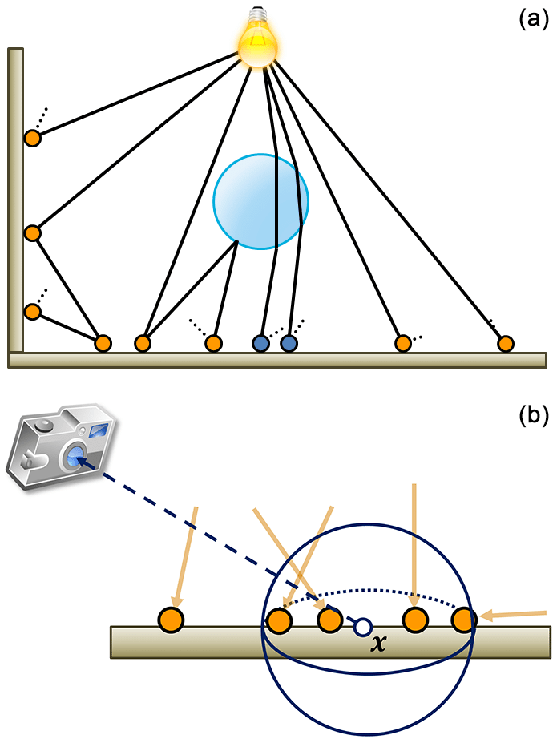
Background: (P)PM
Photon mapping:
Tracing photons from light sources
Storing them in a data structure called “photon map”
Estimating the luminance of each pixels from neighbor photons in photon map
Photon mapping’s overview (a) means step 1&2, (b) means step 3 [2]
4

Slide 5
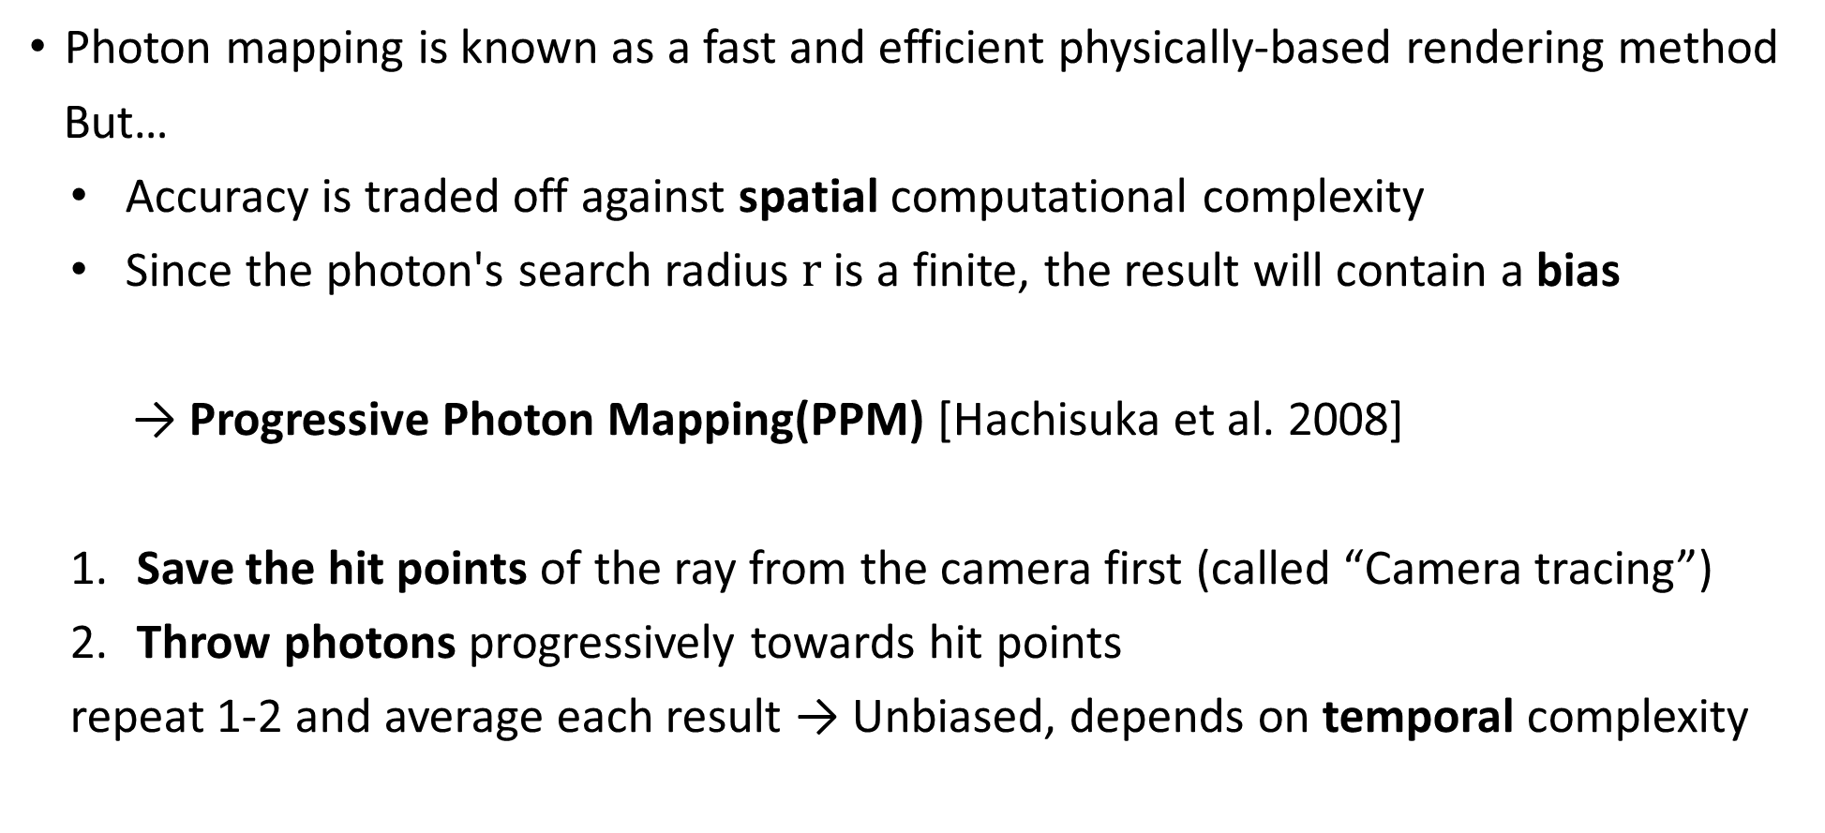
Background: PPM
Photon mapping is known as a fast and efficient physically-based rendering method
But…
Accuracy is traded off against spatial computational complexity
Since the photon's search radius $r$ is a finite, the result will contain a bias
→ Progressive Photon Mapping(PPM) [Hachisuka et al. 2008]
Save the hit points of the ray from the camera first (called “Camera tracing”)
Throw photons progressively towards hit points
repeat 1-2 and average each result → Unbiased, depends on temporal complexity

Slide 6
Overview
These approaches are complementary
BPT: Robust due to MIS from many combinations, but weak against “SDS” path (like caustics)
PPM: Very effective against SDS paths, but it is weak against diffuse reflection
However, these two methods are derived in different way→ difficult to integrate
BPT: Based on path integration framework, consider “vertices” and edges to connect them
PPM: Based on Density estimation, Find the density of photons at the observation point
This method (VCM) integrates them within the path integration framework
Vertex Connection: connect vertices based on MIS, from BPT
Vertex Merging: “merge” near vertices and reuse, from PPM
→ “Vertex Connection and Merging”

Slide 7
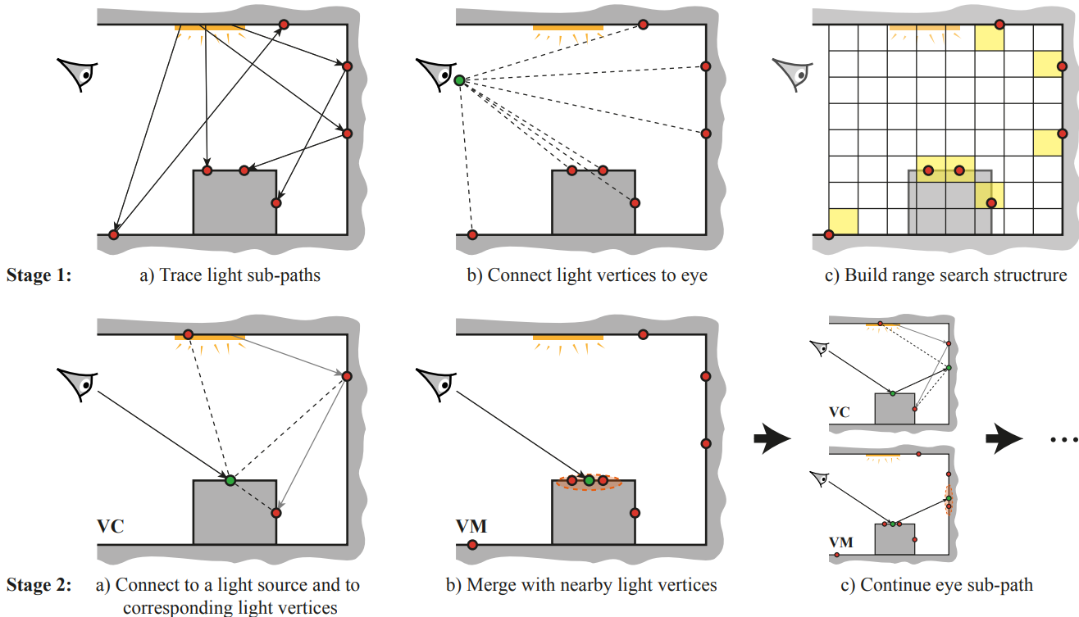
Overview
Overview of VCM method [3]

Slide 8
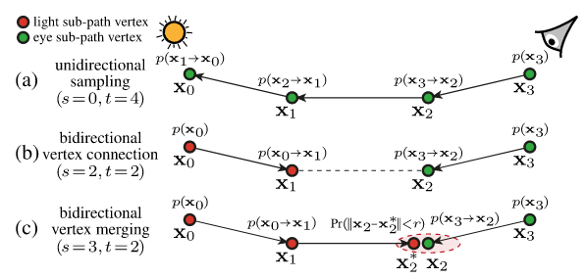
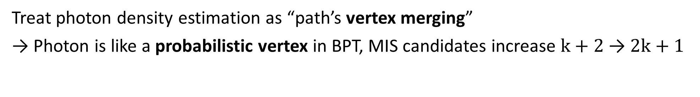

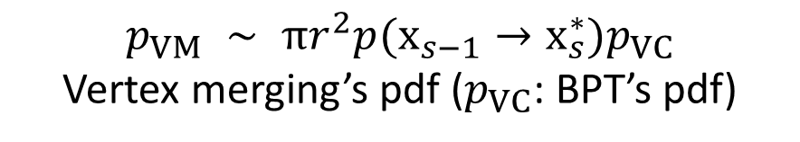
Vertex merging
Treat photon density estimation as “path’s vertex merging”
→ Photon is like a probabilistic vertex in BPT, MIS candidates increase $k+2$ → $2k+1$
$$p_{VM} ∼ πr^{2}p(x_{s−1}→x_{s}^{∗})p_{VC}$$
Vertex merging’s pdf ($p_{VC}$: BPT’s pdf)
Search radius: $r$
Comparison with (a): Standard path tracing, (b): Vertex connection only (BPT), (c): vertex merging

Slide 9
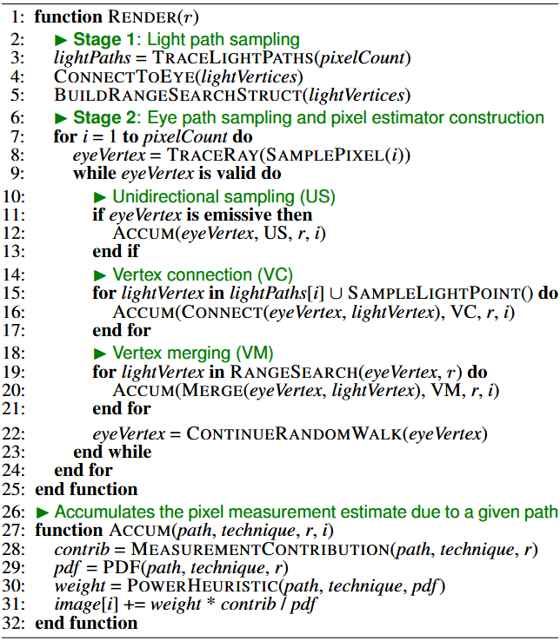
Algorithm
Stage1: Light path sampling
Random path sampling from a light source
→ Save the obtained vertices to range search structure (like photon map)
Stage 2: Eye path sampling and integration
US: Direct contribution from the light source
VC: Connect each vertex of the light path to the current vertex (BPT)
VM: Merge the saved light vertices with
the current vertex
→ Combine their contributions

Slide 10

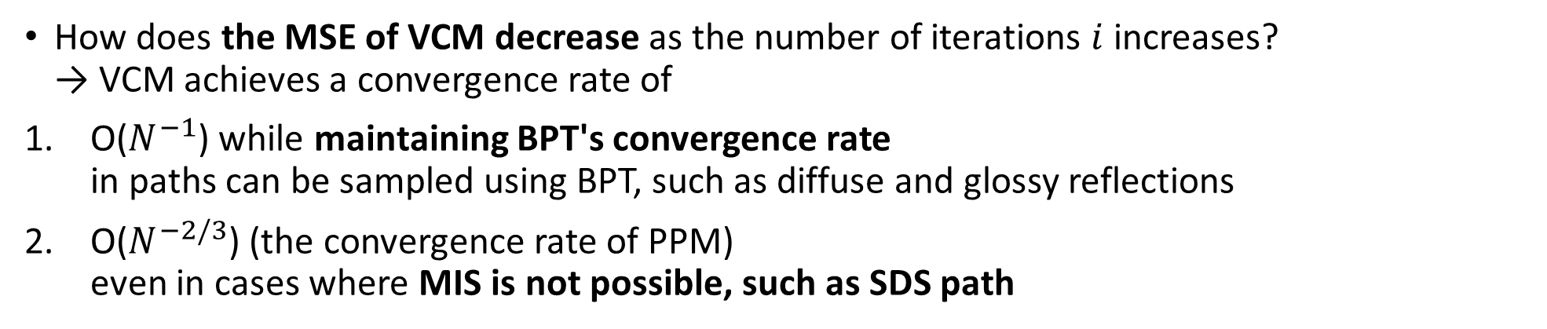
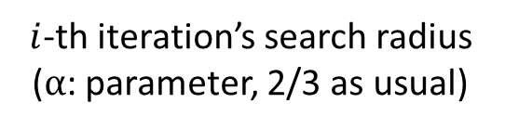
Asymptotic error analysis
VCM has consistency like PPM (Decrease the VM’s $r$ with each iteration)
$$r_{i}=r_{1}⋅i^{\frac{α−1}{2}}$$
$i$-th iteration’s search radius ($α$: parameter, 2/3 as usual)
How does the MSE of VCM decrease as the number of iterations $i$ increases? → VCM achieves a convergence rate of
O($N^{−1}$) while maintaining BPT's convergence rate in paths can be sampled using BPT, such as diffuse and glossy reflections
O($N^{−2/3}$) (the convergence rate of PPM) even in cases where MIS is not possible, such as SDS path
In error analysis as well, VCM have achieved a complementary error rate using both methods

Slide 11
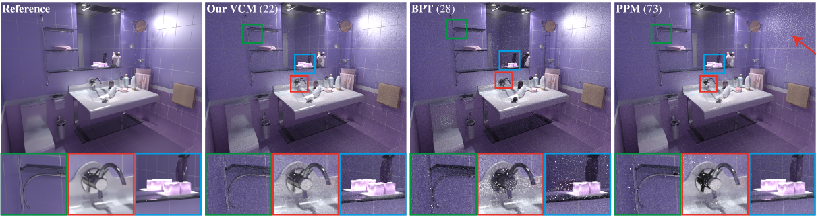
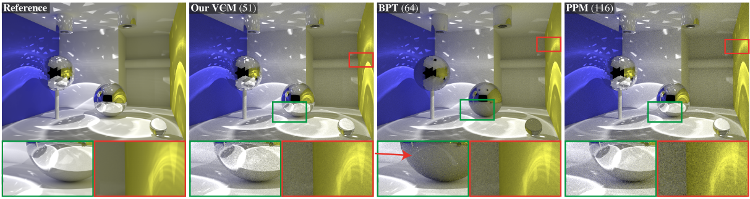
Results (4min comparison)
VCM combines the best features of BPT and PPM (note boxes and arrow)

Slide 12
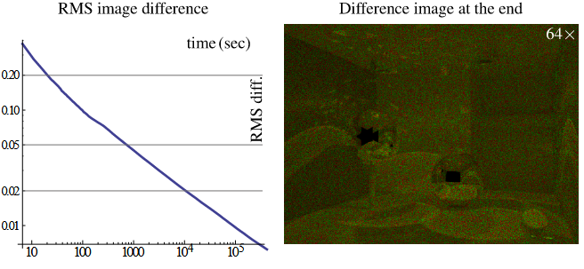
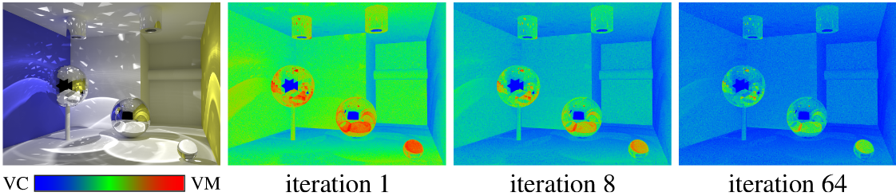
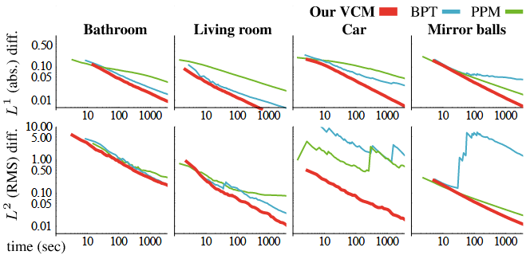
Evaluation
Comparison of convergence between pure PPM and VCM, experimentally demonstrating that VCM is unbiased
Comparison of the contribution rates of VC and VM: As the number of iterations increases, the ratio of VM(which is more prone to error) decreases
Comparison of convergence between BPT and PPM in each scene

Slide 13
Discussion
It is extremely difficult to implement
Even though either one is complex, we need the structures of both BPT and PPM
Calculating MIS after vertex merging is too complex and involves too many steps
The author later even published a technical report that only explained how to implement VCM “Implementing vertex connection and merging” [Georgiev, 2012]
Higher (spatial) computational costs
In addition to the light path, all vertices of the light path must be stored in a range search structure
In scenes with numerous complex reflections and refractions, this is the ultimate all-in-one approach but especially cases which execution speed is needed, it’s rarely necessary…

Slide 14
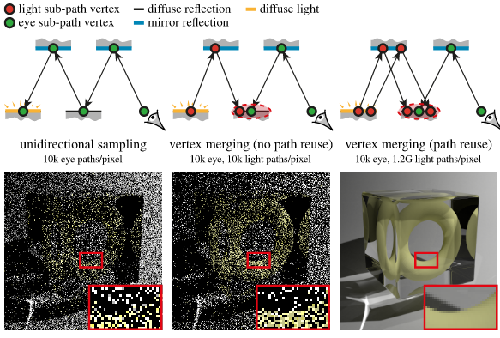
Conclusion
Robust light transport simulation integrating - Bidirectional path tracing (BPT) - (Progressive) Photon mapping (PPM)
Teaser image
Robustness of VCM in the SDS Path

Slide 15
References
[1]: https://www.semanticscholar.org/paper/Bidirectional-Path-Tracing-Vlnas/c9662ee171e68a08600203e975b4c04c770c2598
[2]: https://www.researchgate.net/figure/llustration-of-photon-mapping-a-Light-sources-send-out-energy-as-photons-b-a_fig7_317224001
[3]: “Implementing vertex connection and merging” [Georgiev, 2012]

